Slide 1
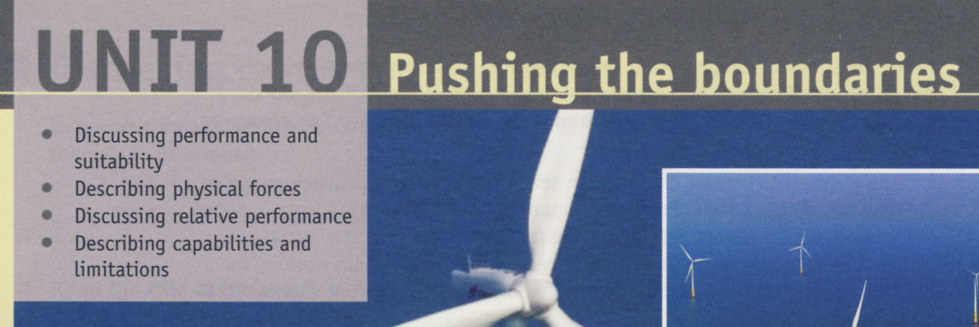

Notes:
Describing physical forces (pages 80 and 81) Analysing different types of physical force plays a fundamental role in engineering design. The specific context of this section – tall structures – is chosen as being useful for exemplifying the main forces. However, the same forces are relevant throughout the various branches of mechanical and civil/structural engineering, and the study of forces is a core subject in all engineers’ education. Enviromission solar tower

Slide 2
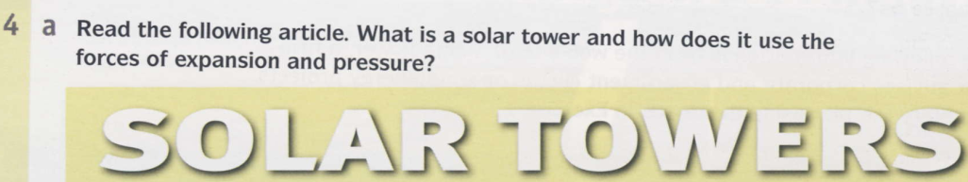
Before we begin …
Explain what is meant by force (= a push or pull). What effect do forces have on objects? They cause them to move, deform (= change shape or both).
this section aims to explore different types of force that are fundamental in engineering, this section looks at an unusual project being planned in Australia which aims to push the boundaries in both structural engineering and green energy.
Notes:
Language note You will find the following vocabulary useful in this section. bending, centrifugal force, compression, contraction, expansion, friction, pressure, shear, tension/torque

Slide 3
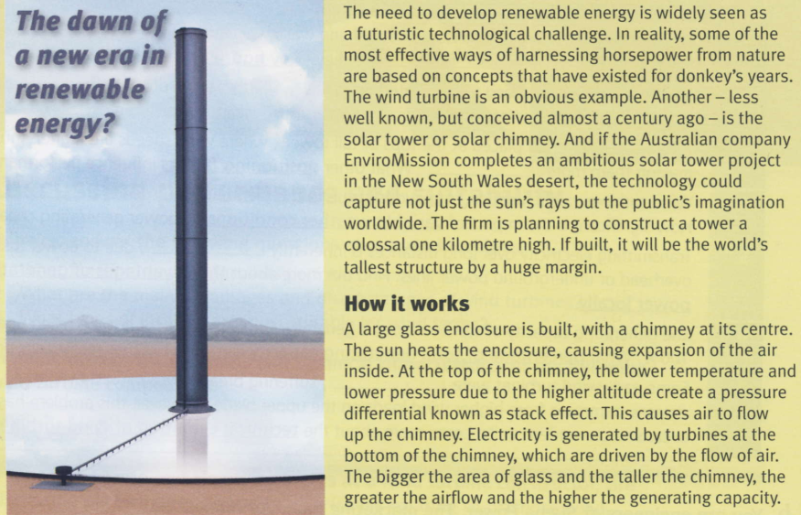

Slide 4
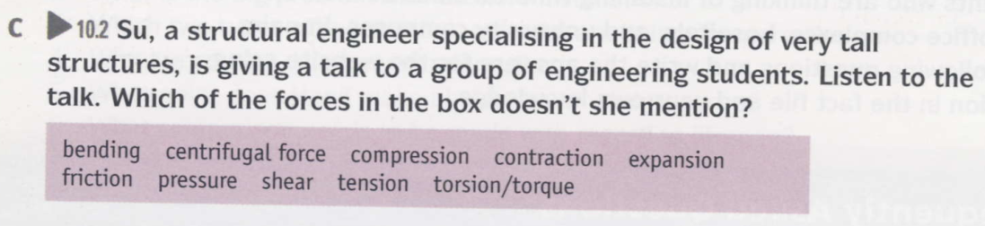

crushing, stretching, sliding, twisting, wobbling
Answer: She doesn’t mention centrifugal force.

Slide 5
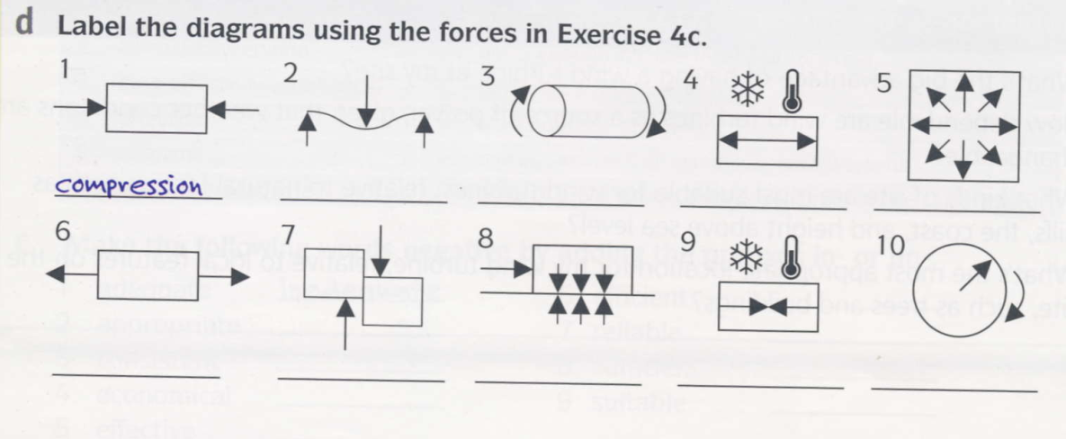
Notes:
2 bending 7 shear 3 torsion/torque 8 friction 4 expansion 9 contraction 5 pressure 10 centrifugal force 6 tension

Slide 6
bending
torsion/torque
expansion
pressure
tension
friction
contraction
shear
centrifugal force
Notes:
2 bending 7 shear 3 torsion/torque 8 friction 4 expansion 9 contraction 5 pressure 10 centrifugal force 6 tension

Slide 7
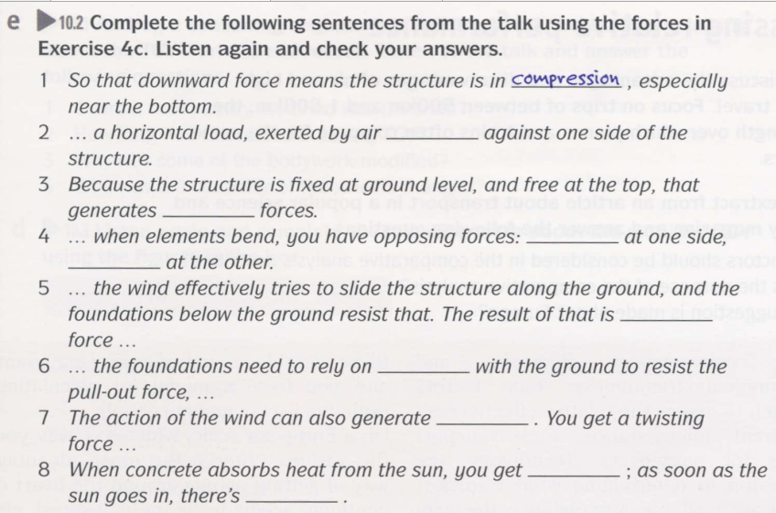

Notes:
2 pressure 3 bending 4 compression; tension 5 shear 6 friction 7 torsion (torque) 8 expansion; contraction

Slide 8
pressure
bending
compression
tension
shear
friction
torsion (torque)
expansion
contraction
Notes:
2 pressure 3 bending 4 compression; tension 5 shear 6 friction 7 torsion (torque) 8 expansion; contraction

Slide 9
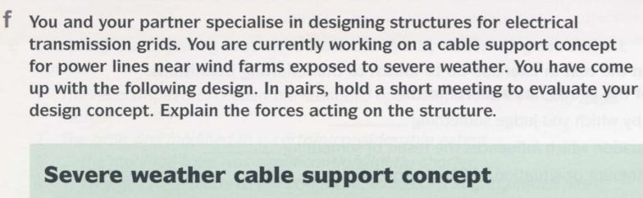
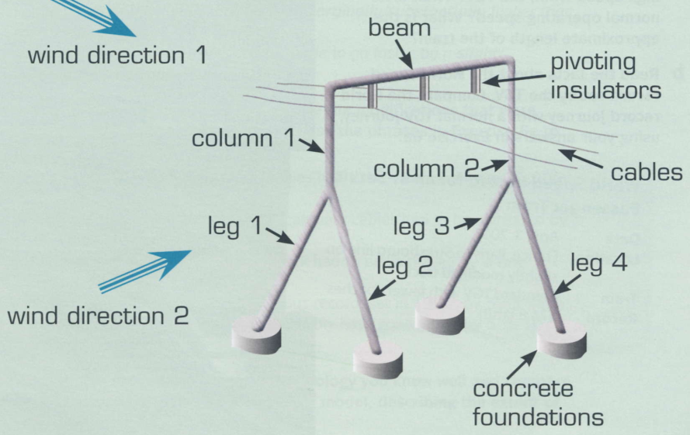

Slide 10
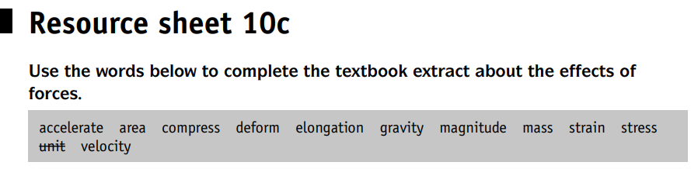
TB 128

Slide 11
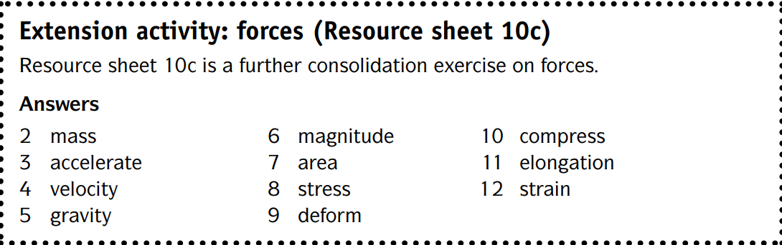
TB 128

